Slide 1



Week – 1 ML & Python 101
ML Bootcamp 2021

Slide 2
Table of contents
01
05
02
04
06
What is ML/AI?
03
Why Python?
Common Packages
We will understand this magical thing!
We will understand why it is so popular in recent years
Most commonly used libraries
Applications
ML/Programming jargon
Hands-on
Various applications from Face recognition to text analytics
Lets start practicing!
Some technical terms to understand

Slide 3
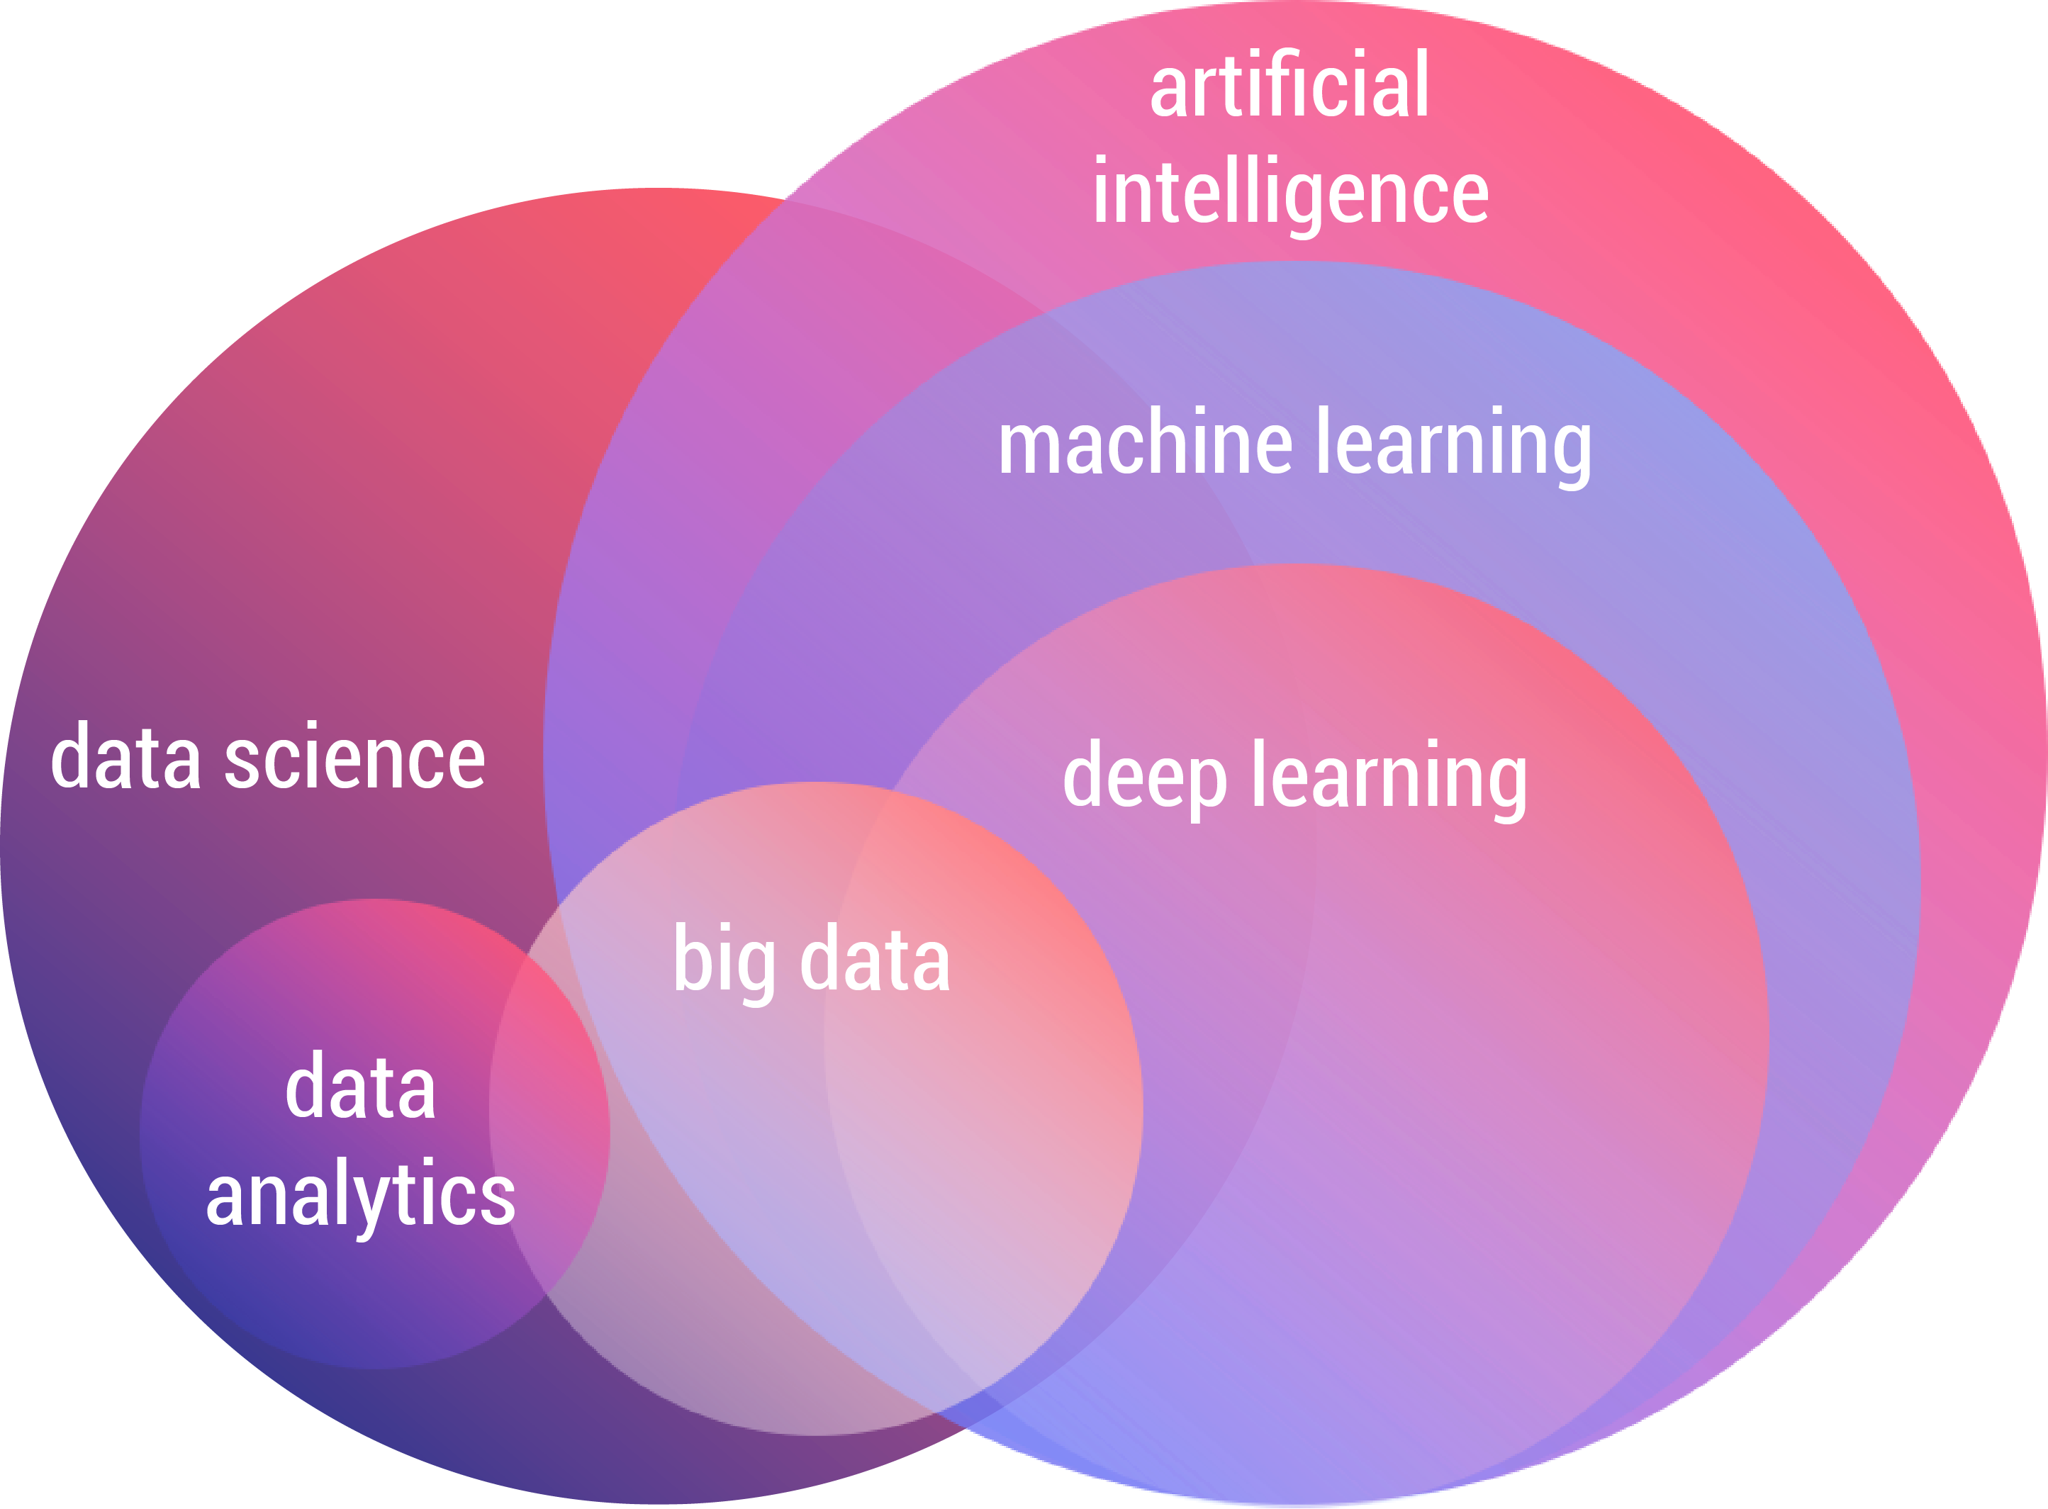
The AI Landscape

Slide 4
Applications of Artificial Intelligence
Computer Vision: Face recognition, Object detection, Video Quality Assessment
Natural Language Processing: Next word prediction(email, phone etc.), Question-Answering, Text Summarization
Time Series Forecasting: Stock market trend predictions, weather predictions \
Fraud Detection: Detecting Outliers/Anomalies in banking and other related fields

Slide 5
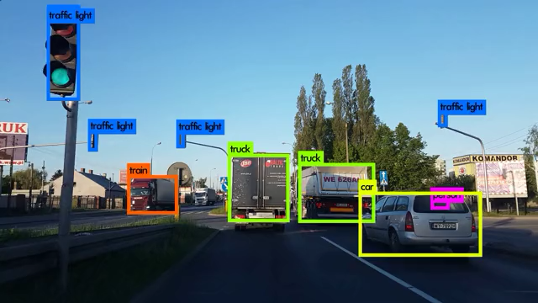
Computer Vision in action

Slide 6

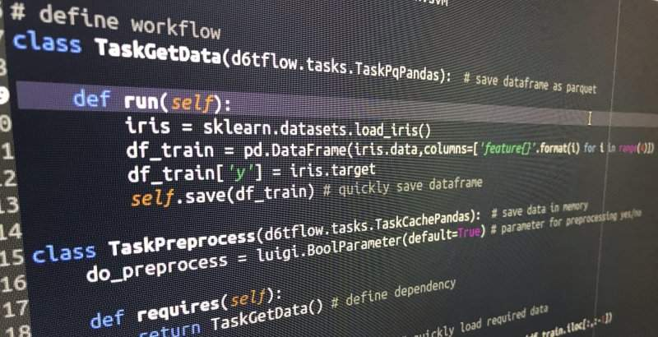
“Reel” AI
“Real” AI

Slide 7

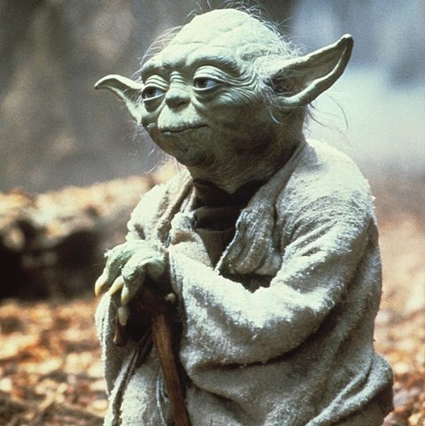
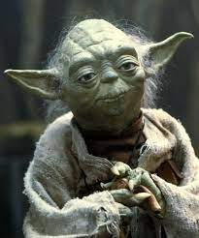
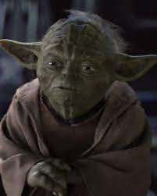


The Yoda Challenge

Slide 8
The ML Tech Stack
Good Programming skills
Python
Machine Learning Algorithms
Basic Statistics & Probability concepts
Patience to read research papers
Databases and SQL
Application Development concepts: Web apps, cloud computing
Some idea behind Data Lakes and related concepts
Our focus for today

Slide 9
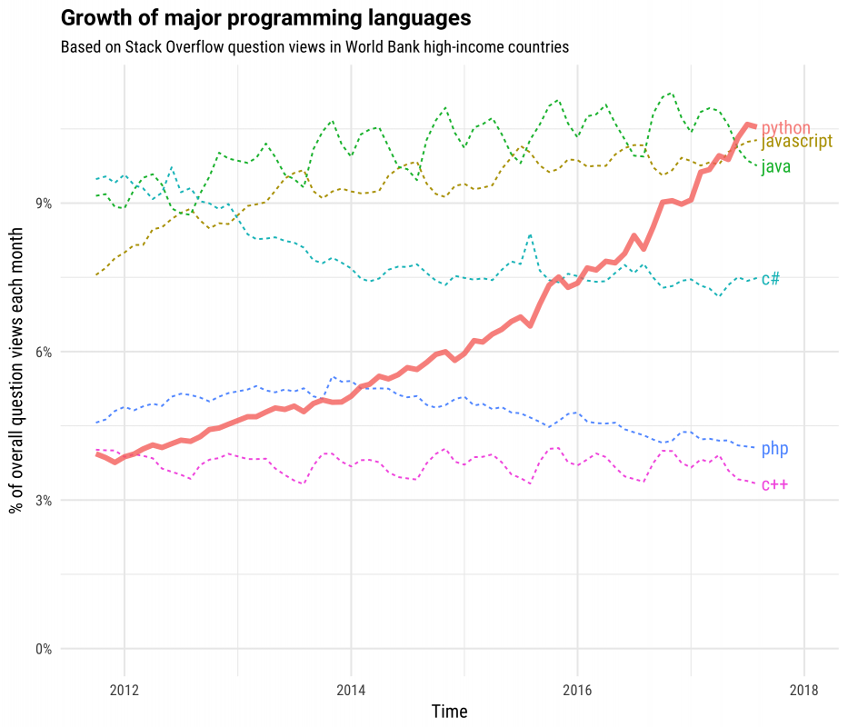
Why is Python so popular?
Human-like language
Easy to read and understand
Interpreted language
Problem solution first, implementation later
Libraries are easy to use

Slide 10


Slide 11
ML jargon
Datasets: The data that you process, transform and use to train your ML models
Features: The individual columns(if it is a table) in your data
Supervised/Unsupervised: Either with or without answers
Classification: Predicting a limited set of outputs Eg: Pos/Neg sentiment, Cat/Dog, Bearish/Bullish
Regression: Output has an infinite possibilities Eg: Housing prices, stock prices, time etc.
Machine Learning: A set of algorithms or a method to learn through experience using data
Deep Learning: Just a fancy word for Neural Networks
Training and Testing: We usually split our data into two parts, one to train the model and another to test the model's performance
Functions: A block of code with a name that can be called to execute a set of statements
Library: A collection of functions grouped under one single name
Package: A collection of script (*.py) files containing modularized code

Slide 12
Commonly used libraries
Pandas
Numpy
Scikit-learn
Popular library for data transformations and manipulations
A scientific computing package for Python
The home of all Machine Learning Algorithms!

Slide 13
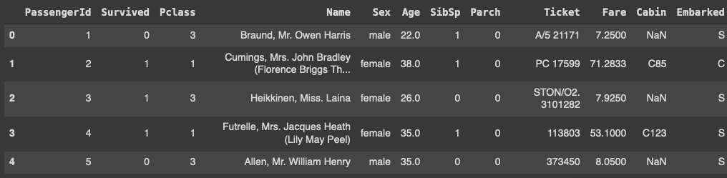
Pandas Dataframe
Features/Columns
String Categorical Numerical
Pandas Series object
Missing Value
Data point

Slide 14
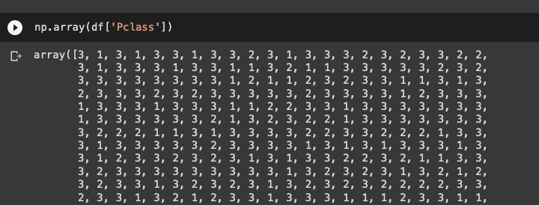
Numpy
At the core of the NumPy package, is the ndarray object -- numpy.org

Slide 15
Lets start Practicing!

Slide 16
Thanks
Do you have any questions?

Slide 17


